Slide 1
Fighting to Defend the Gospel
Philippians series 2019

Slide 2
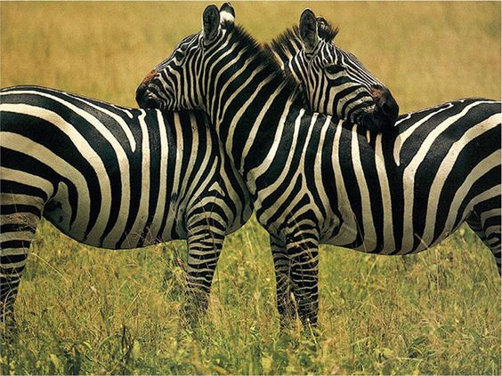

Slide 3
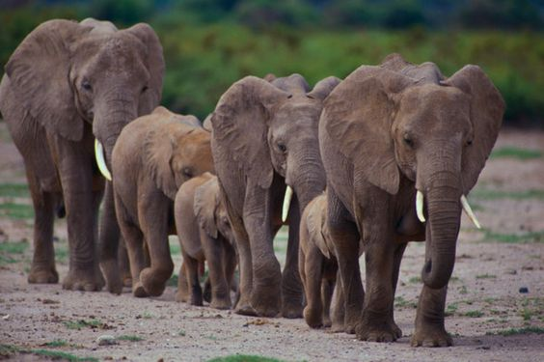
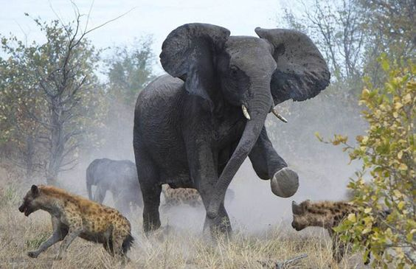

Slide 4
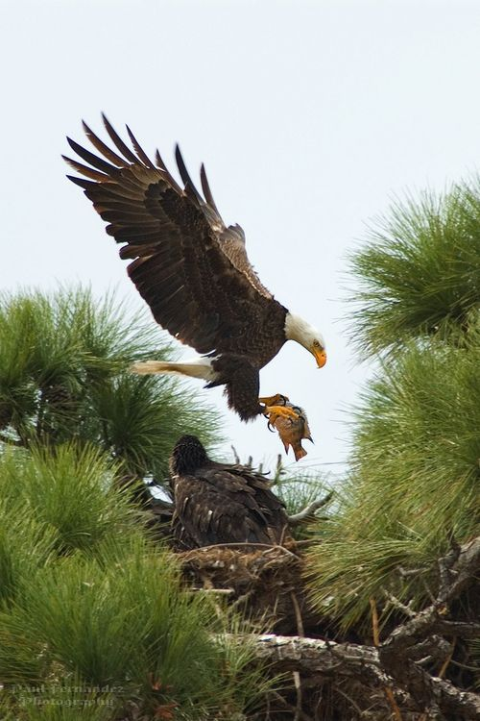
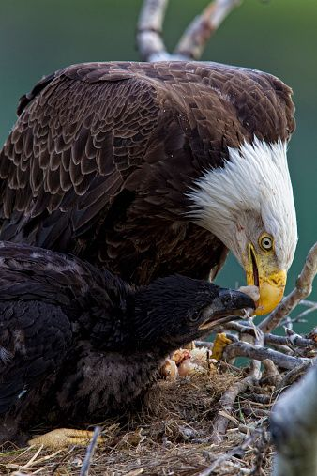

Slide 5
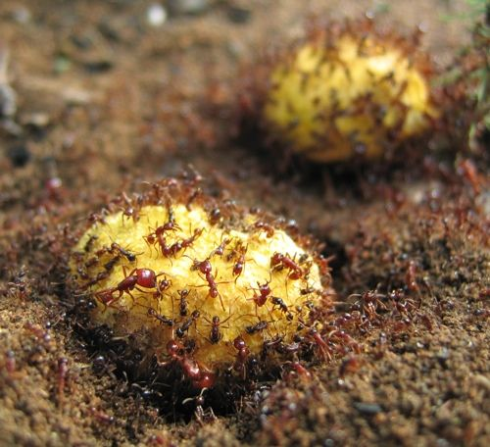

Slide 6
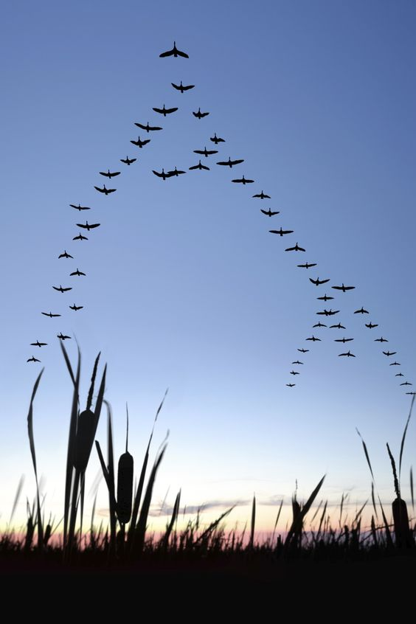
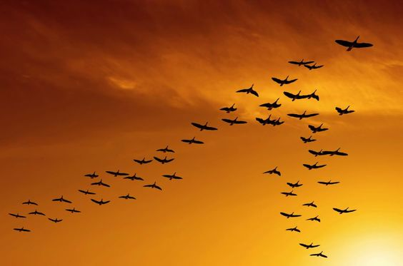

Slide 7
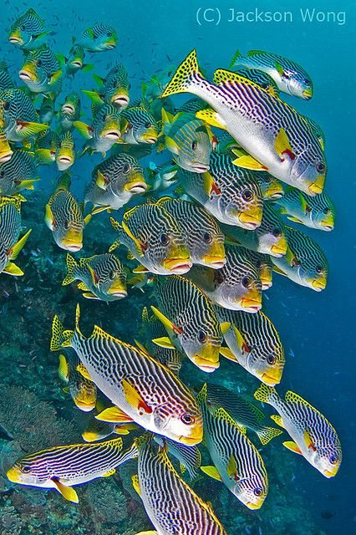
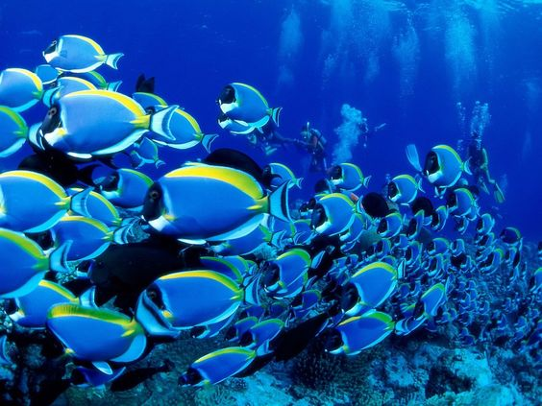

Slide 8
Proverbs 30:24-27 (NIV)
²⁴ “Four things on earth are small, yet they are extremely wise: ²⁵ Ants are creatures of little strength, yet they store up their food in the summer;

Slide 9
²⁶ hyraxes (Rock Badgers) are creatures of little power, yet they make their home in the crags (rocks);
²⁷ locusts have no king, yet they advance together in ranks;
²⁸ a lizard can be caught with the hand, yet it is found in kings’ palaces.

Slide 10
1 Timothy 6:20 (NIV)
20 Timothy, guard what has been entrusted to your care (speaking about the gospel). Turn away from godless chatter and the opposing ideas of what is falsely called knowledge,

Slide 13
Philippians 1:27-30 (NIV)
27 Whatever happens, conduct yourselves in a manner worthy of the gospel of Christ.

Slide 14
Then, whether I come and see (all of) you or only hear about (all of) you in my absence, I will know that (all of) you stand firm in the one Spirit, striving together as one for the faith of the gospel 28 without being frightened in any way by those who oppose (all of) you. This is a sign to them that they will be destroyed, but that (all of) you will be saved—and that by God.

Slide 15
29 For it has been granted to (all of) you on behalf of Christ not only to believe in him, but also to suffer for him, 30 since (all of) you are going through the same struggle you saw I had, and now hear that I still have.

Slide 16
Fighting to Defend the Gospel

Slide 17
1. Fighting Consistently1:27 (NIV)
27 Whatever happens, conduct yourselves in a manner worthy of the gospel of Christ.

Slide 18
Jude 3(NIV)
3 Dear friends, although I was very eager to write to you about the salvation we share, I felt compelled to write and urge you to contend for the faith that was once for all entrusted to God’s holy people

Slide 19
2. Fighting Collaboratively (together)
1:27b-28…Then, whether I come and see (all of) you or only hear about (all of) you in my absence, I will know that (all of) you stand firm in one Spirit, striving together as one for the faith of the gospel 28 without being frightened in any way by those who oppose (all of) you. This is a sign to them that they will be destroyed, but that (all of) you will be saved—and that by God.

Slide 20
2 Corinthians 10:4 (NIV)
⁴ The weapons we fight with are not the weapons of the world. On the contrary, they have divine power to demolish strongholds.

Slide 21
3. Fighting Confidently 1:29-30 (NIV)
29 For it has been granted to (all of) you on behalf of Christ not only to believe in him, but also to suffer for him, 30 since (all of) you are going through the same struggle you saw I had, and now hear that I still have.

Slide 22
Ephesians 6:11-13 (NIV)
11 Put on the full armor of God, so that you can take your stand against the devil’s schemes. 12 For our struggle is not against flesh and blood, but against the rulers, against the authorities, against the powers of this dark world and against the spiritual forces of evil in the heavenly realms.

Slide 23
13 Therefore put on the full armor of God, so that when the day of evil comes, you may be able to stand your ground, and after you have done everything, to stand.

Slide 24
Fighting Confidently 1:29-30 (NIV)
29 For it has been granted to (all of) you on behalf of Christ not only to believe in him, but also to suffer for him, 30 since (all of) you are going through the same struggle you saw I had, and now hear that I still have.

Slide 25
John 16:33 (NIV)
³³ “I have told you these things, so that in me you may have peace. In this world you will have trouble. But take heart! I have overcome the world.”

Slide 26
Colossians 1:13-14 (NIV)
¹³ For he has rescued us from the dominion of darkness and brought us into the kingdom of the Son he loves, ¹⁴ in whom we have redemption, the forgiveness of sins.

Slide 29
Fighting to Defend the Gospel Together
1. Fighting Consistently
2. Fighting Collaboratively (together)
3. Fighting Confidently

